Slide 1
Development of an AI based algorithm for detection of several detector artifacts
Vrinda Gupta
Internal Supervisor : Dr.-Ing. V. Christlein, Florian Kordon, M.Sc.
External Supervisor: Dr. Thorsten Ergler, Dr. Bastian Schmidt
In collaboration with Siemens-Healthineers

Slide 2
Content
Motivation
Problem Statement
Dataset and Dataset preprocessing
Experiments
Image based
Time based
One-class-classifier
Comparative result analysis
Discussion and future outlook

Slide 3
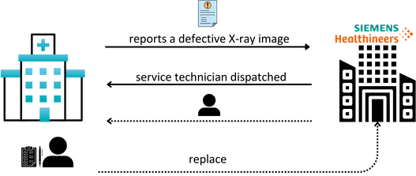
Motivation
Quality assurance
Manual process
Fig: From the 3.74 million imaging tests that were taken in England in June of 2023, around 50 percent were X-ray

Slide 4
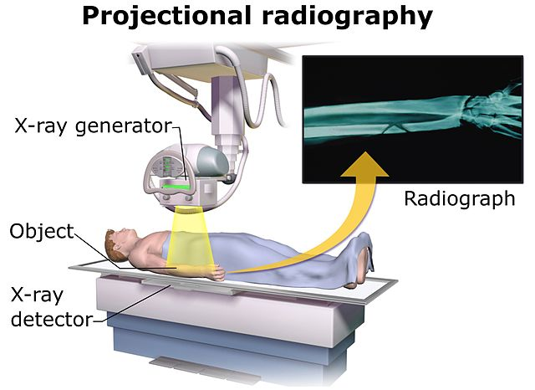
Problem Statement
Task
Classify clinical X-ray images for artifacts
Artifact Type: Technical artifacts from a specific flat panel detector (not anatomical artifact)
Method: AI
Technical use case:
Storage of X-ray images with artifacts
Perform assessment on detectors health
Ensure high-quality diagnostic images for clinical use
Source: https://en.wikipedia.org/wiki/Projectional_radiography

Slide 5
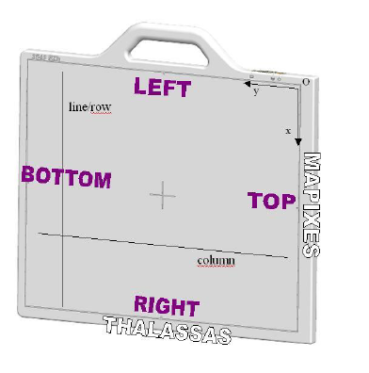
Dataset
2350*2866 16-bit clinical raw X-ray images
Image-level labels with 7 defect and 1 good class
Detector artifacts!!
Multi-label
Fig: MAX wi-D Detector (Source: Siemens)

Slide 6
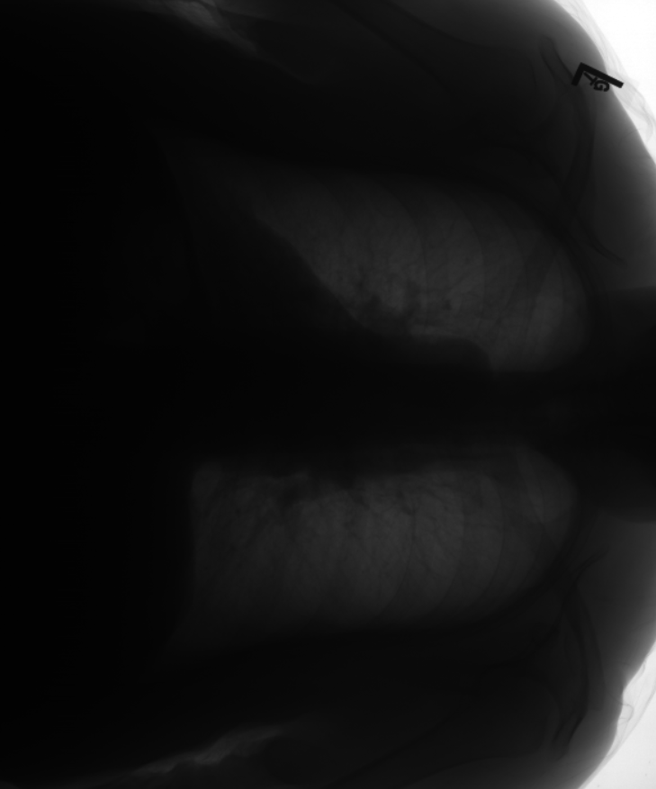
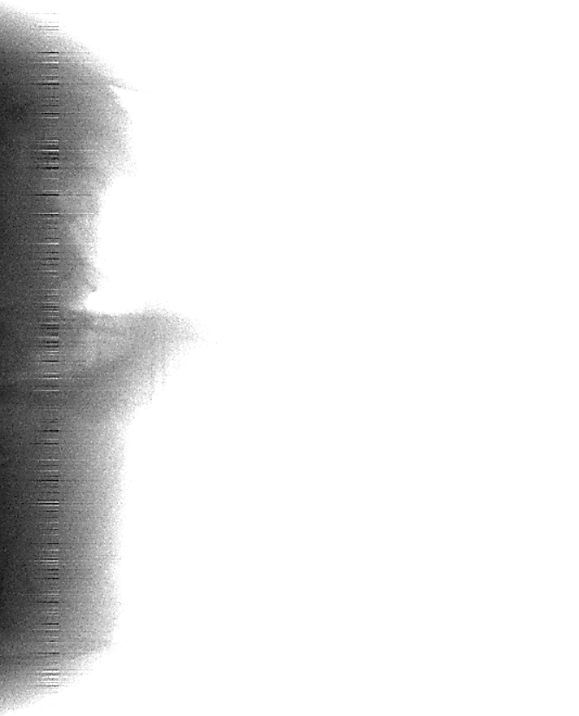
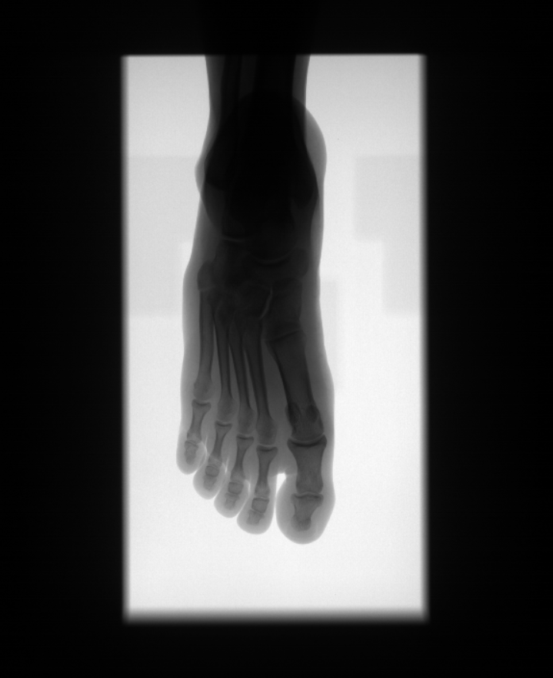
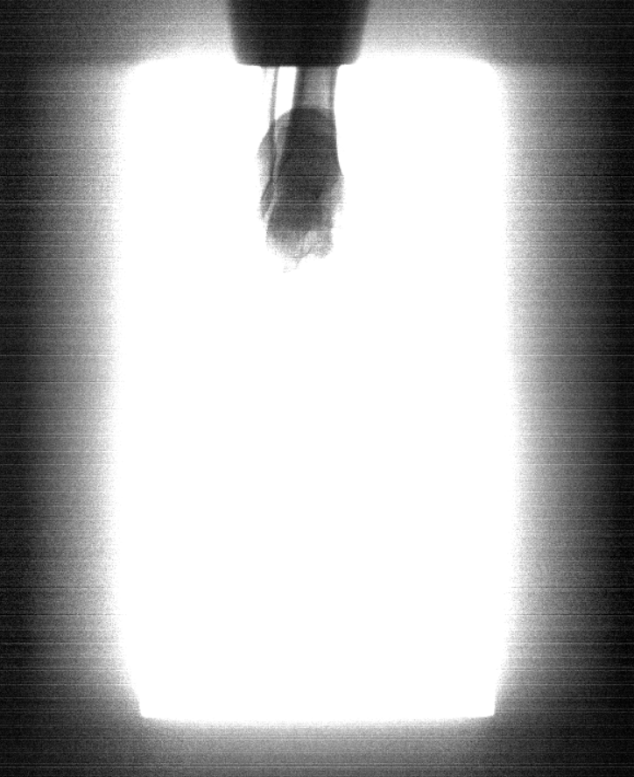
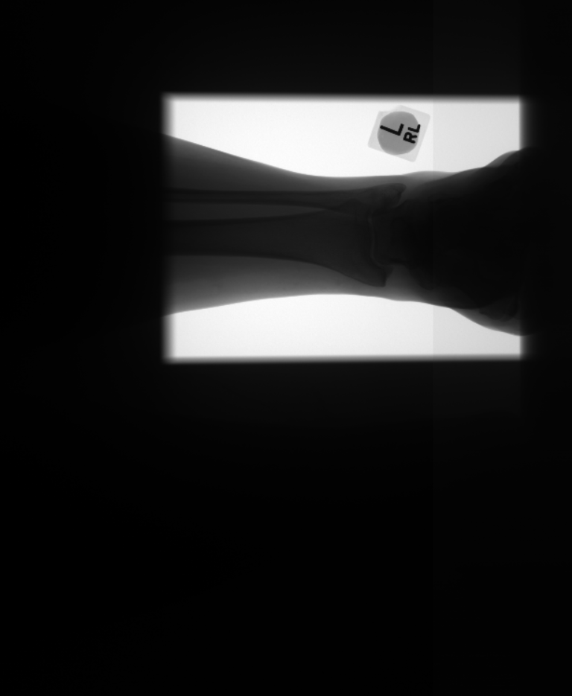
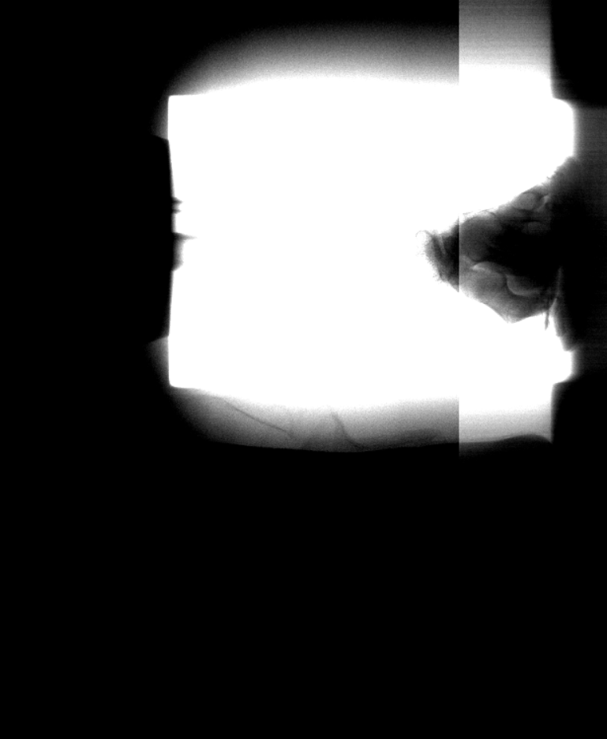
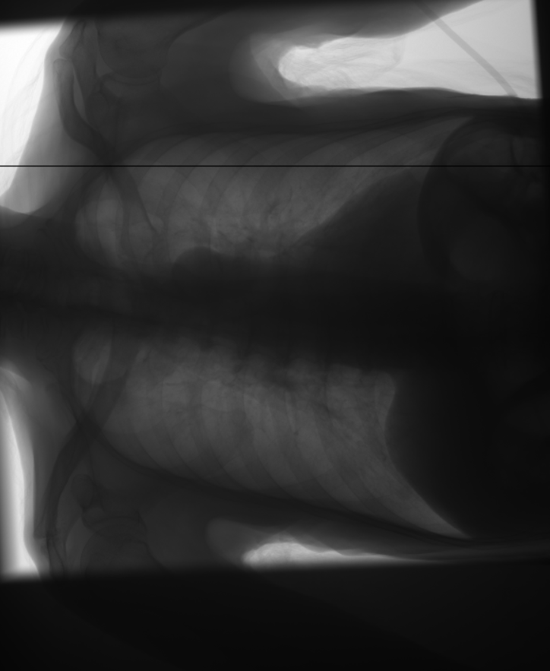
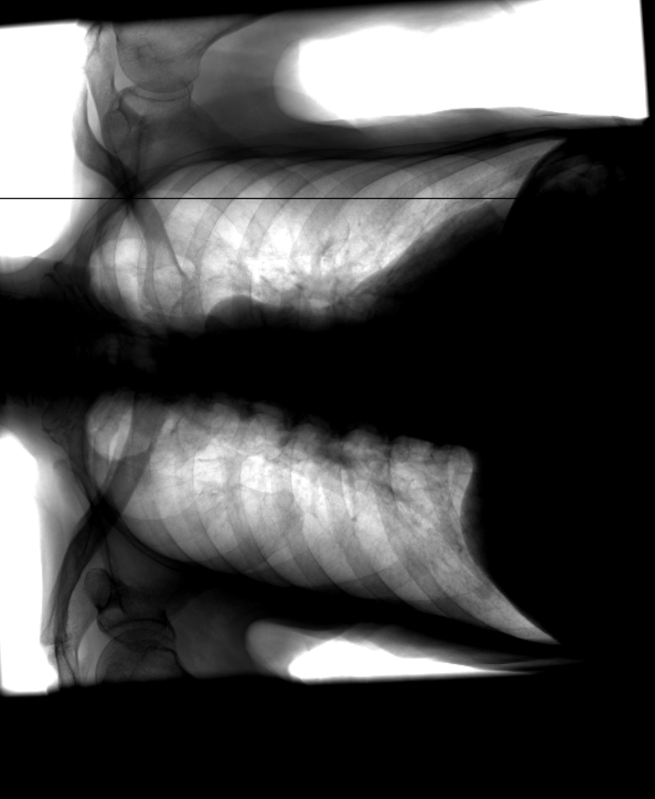
Artifacts
Fig: Group of Line Artifact
Fig: Sporadic Artifact
Fig: Partly Brighter/Darker
Fig: Defect Line

Slide 7
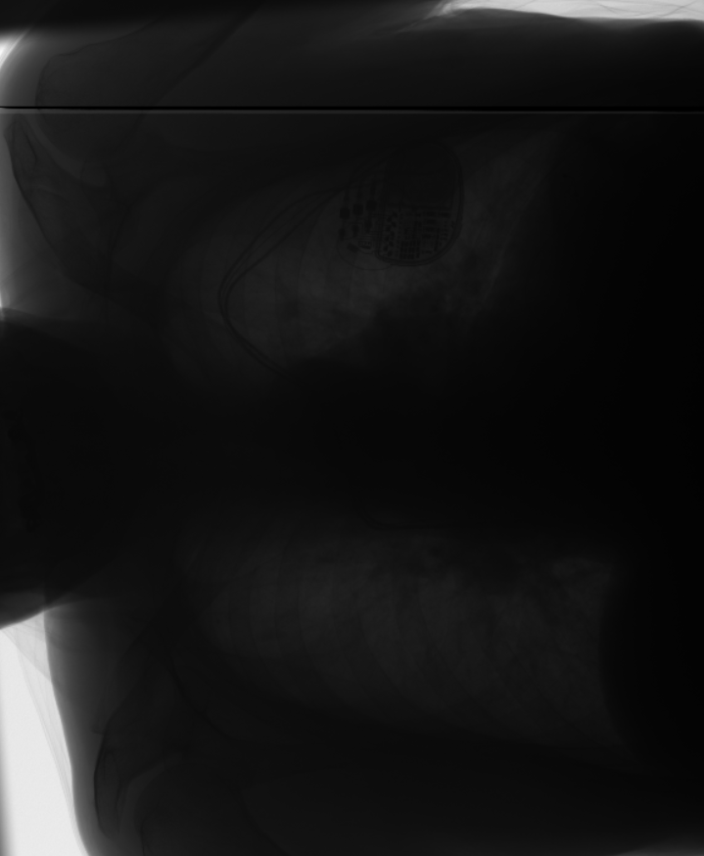
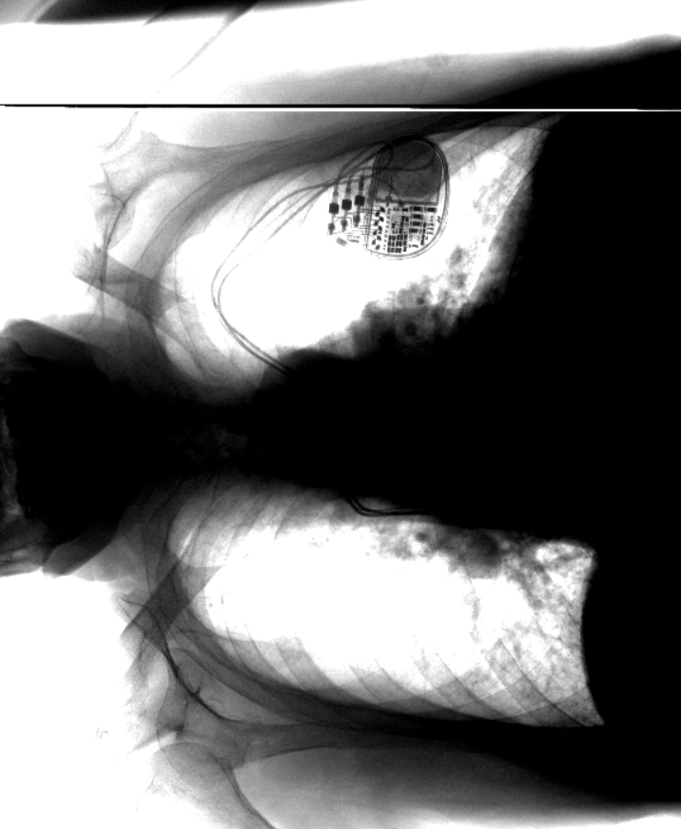
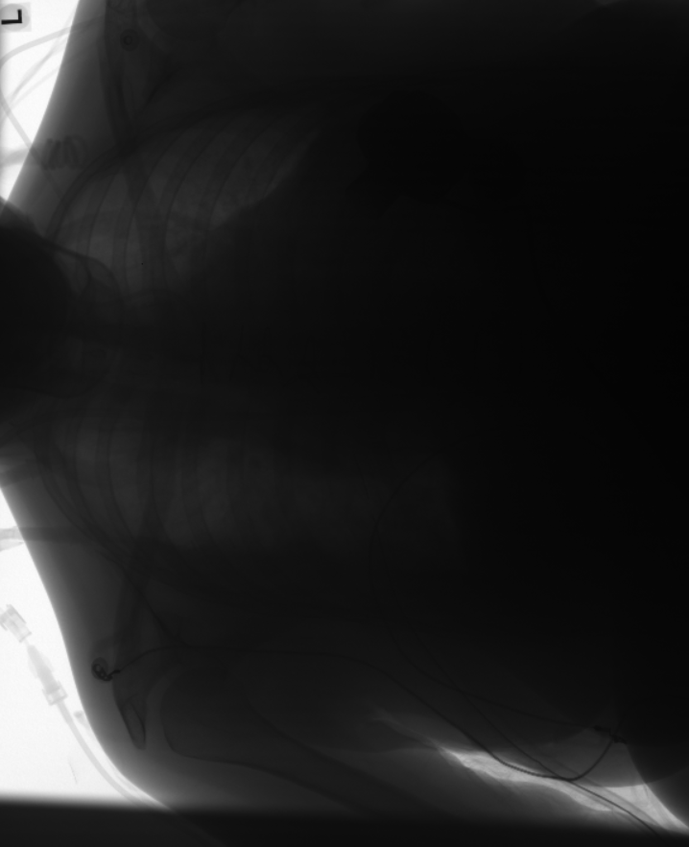
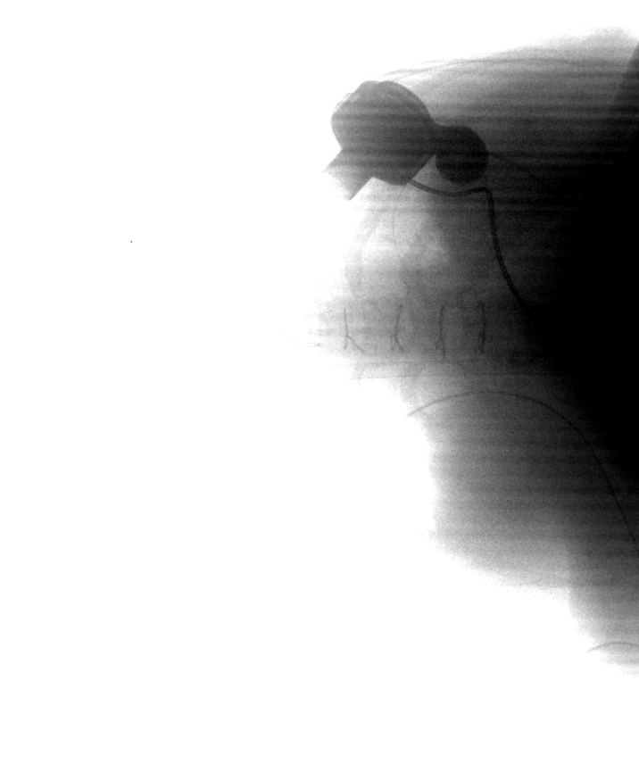
Artifacts
Fig: Group of defect lines
Fig: Stripes

Slide 8
Dataset
Data Scarcity
Data Imbalance
Artifact class | count
FX00_Sporadic_line_artifacts | 67
FX01_Line_artifact | 16
FX02_Group_of_line_artifacts | 6
FX03_partly_brighter | 11
FX04_Group_of_defect_lines | 9
FX05_defect_line | 74
FX09_stripes | 13
good_images | 521

Slide 9
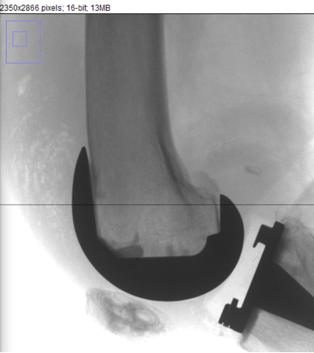
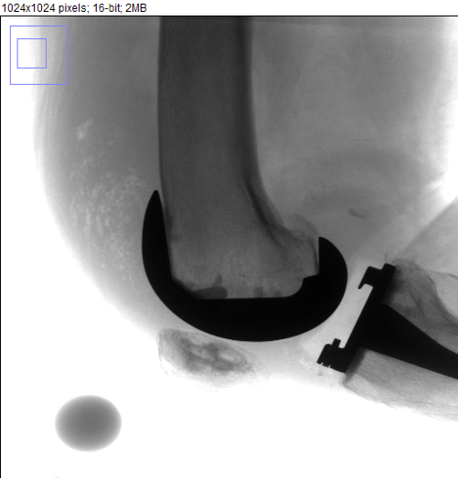
Dataset preprocessing
Image size of 2350 * 2866 is large
Significant computational demands
Limitations on the batch size 1
Data resampling does
not work!
1024 * 1024
2350 * 2866

Slide 10
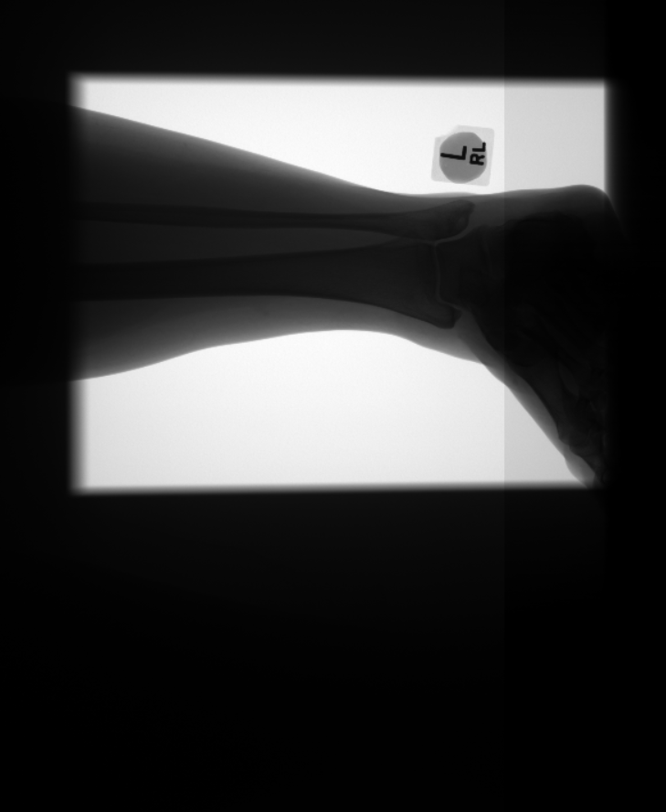

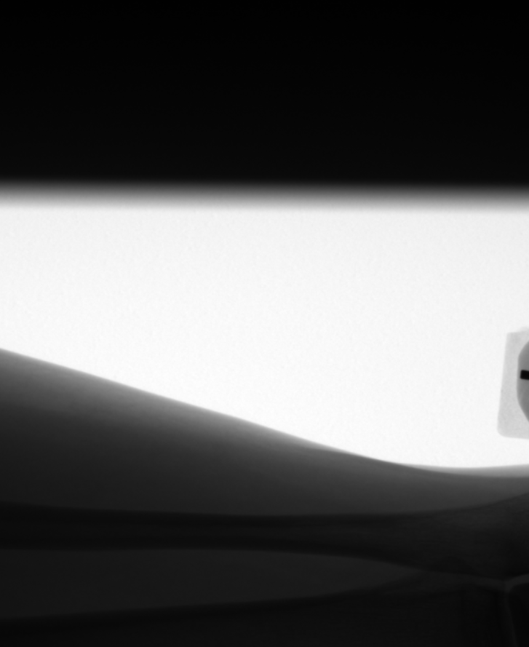
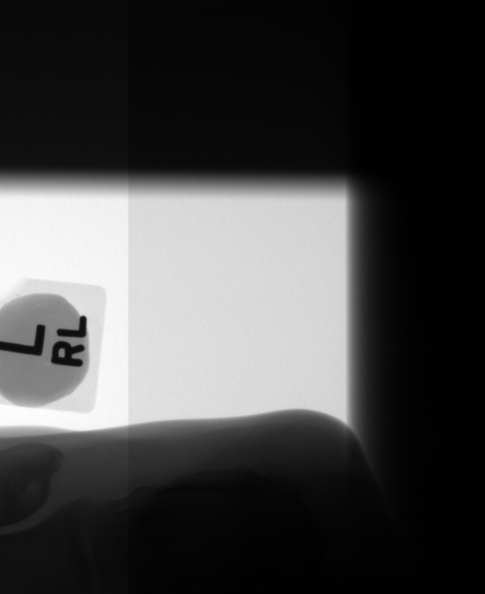
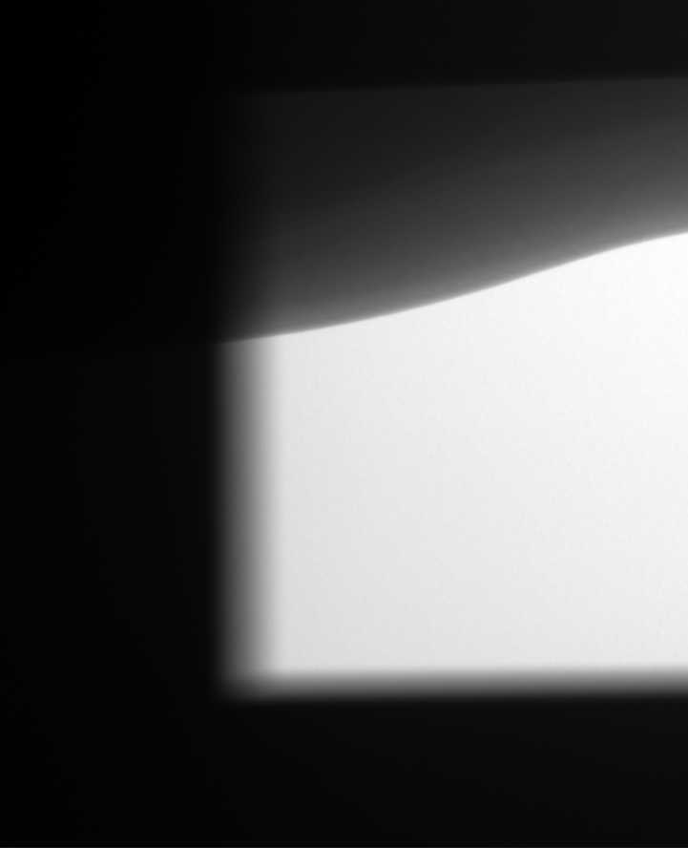
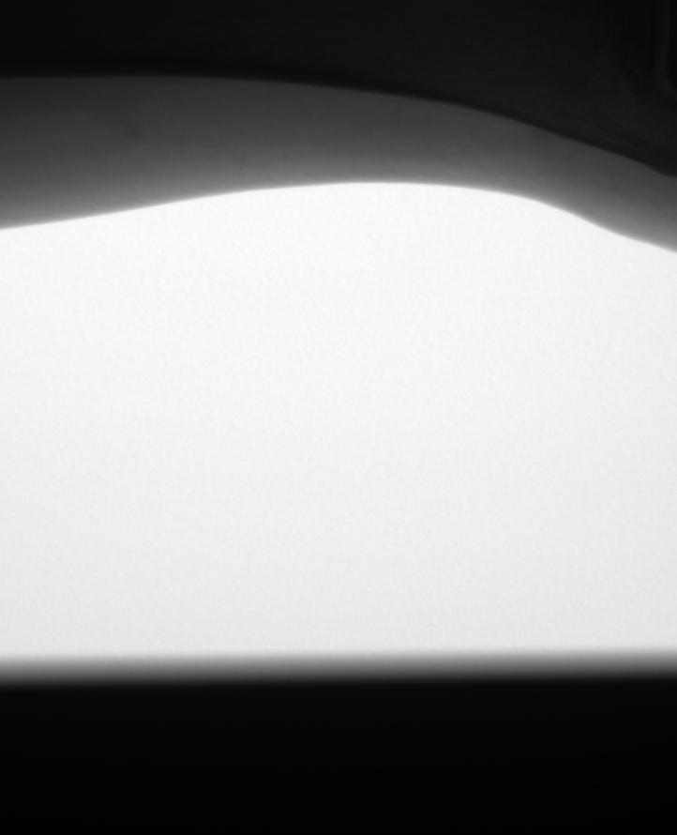

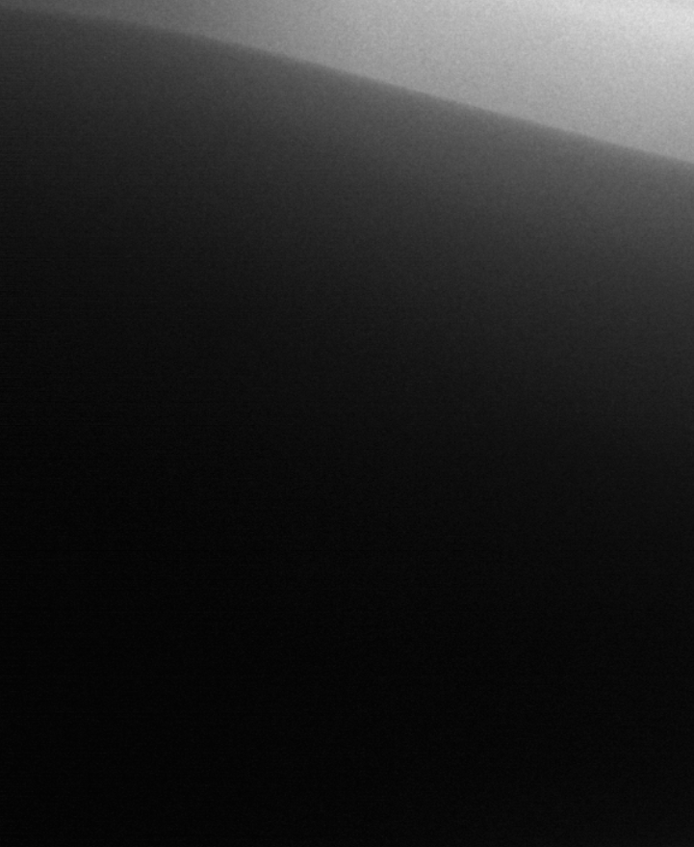
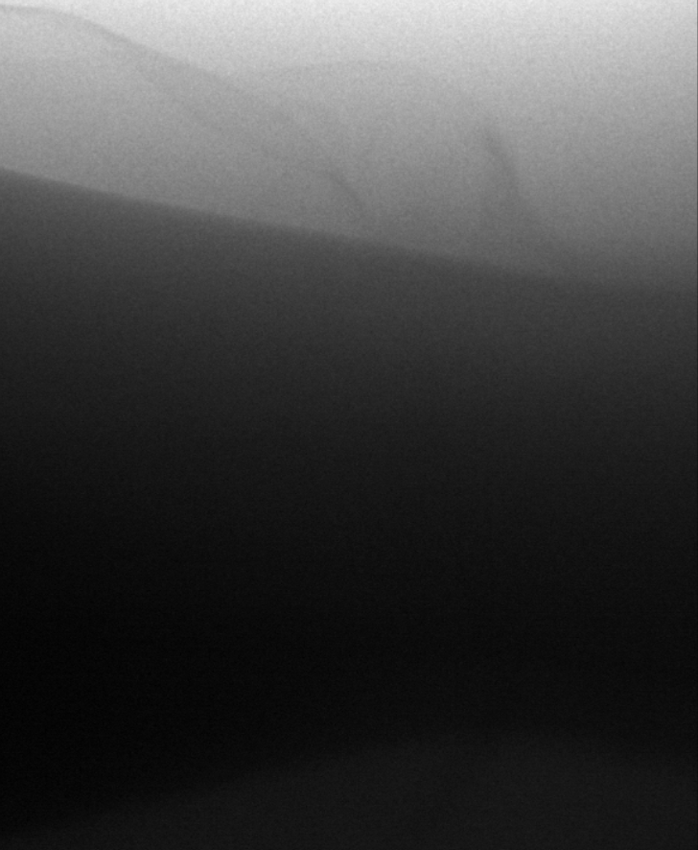
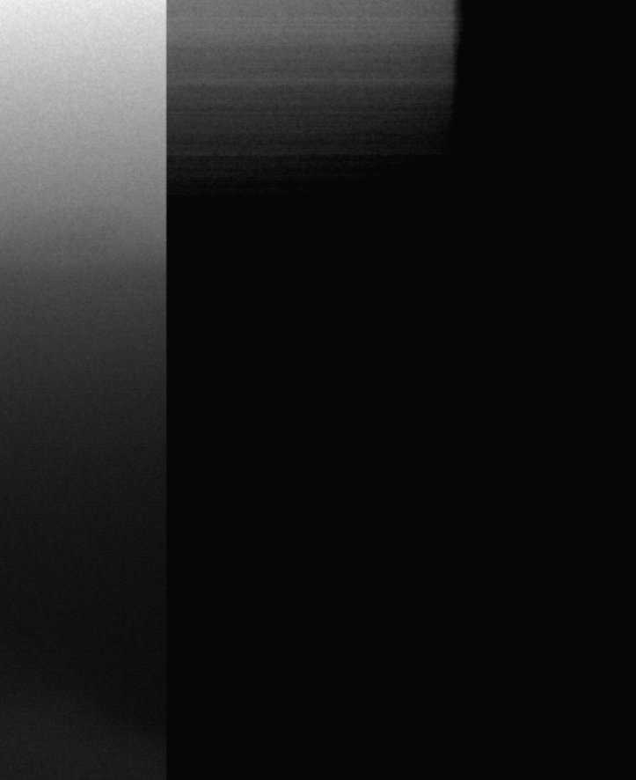
Dataset preprocessing
A
B
C
A
B
C
A- Sporadic line artifact
B- Good image
C- Partly bright/dark
A
B
C
2350*2866
783*955

Slide 11
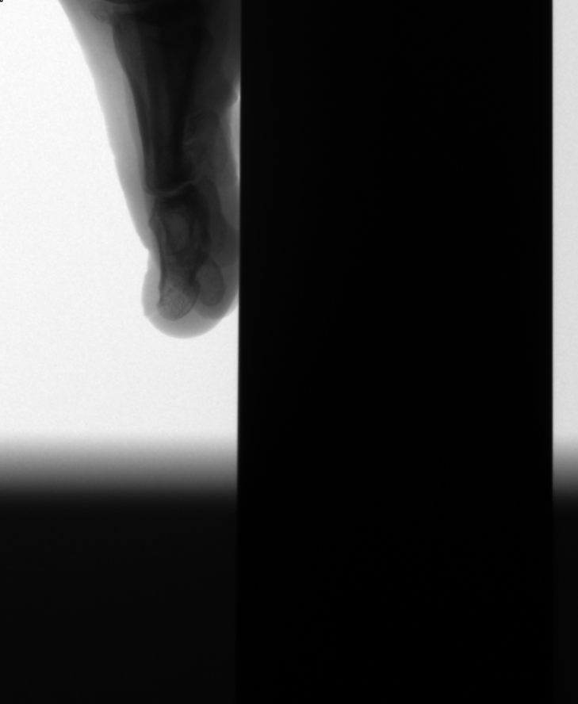
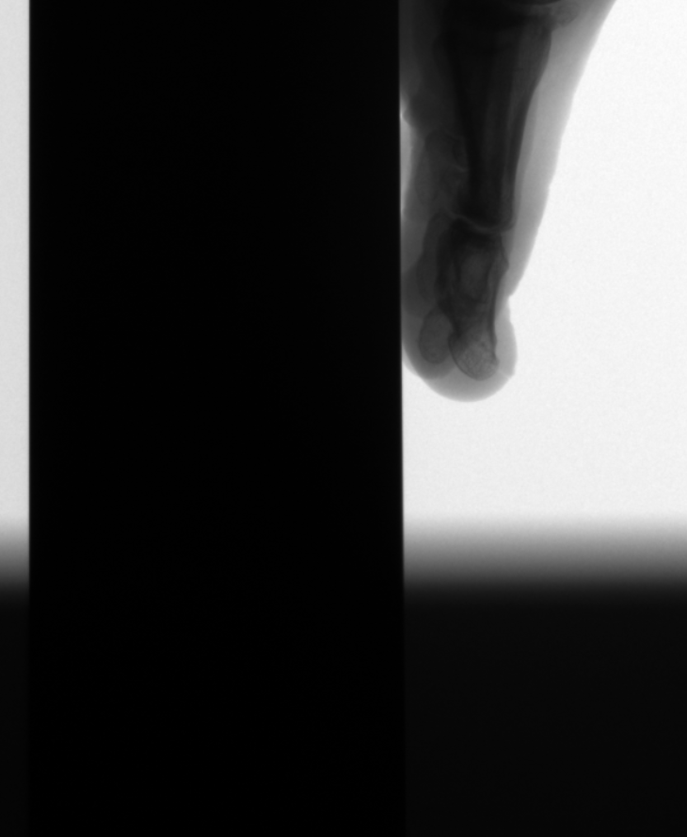
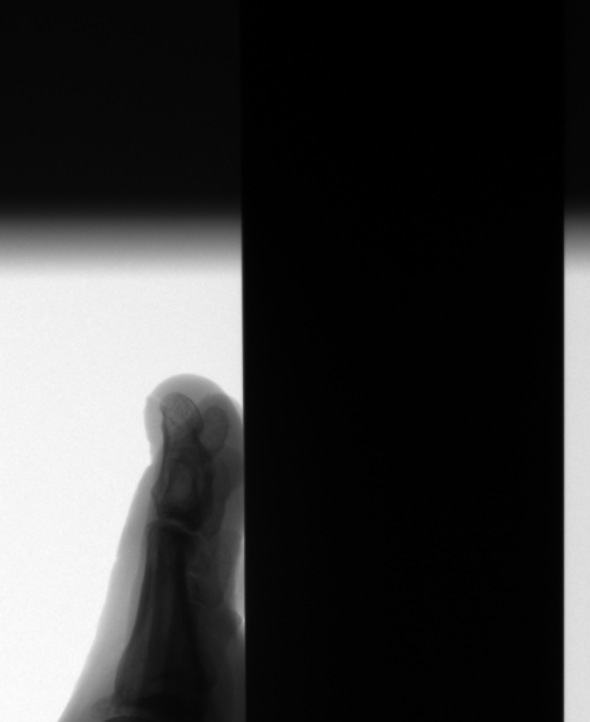
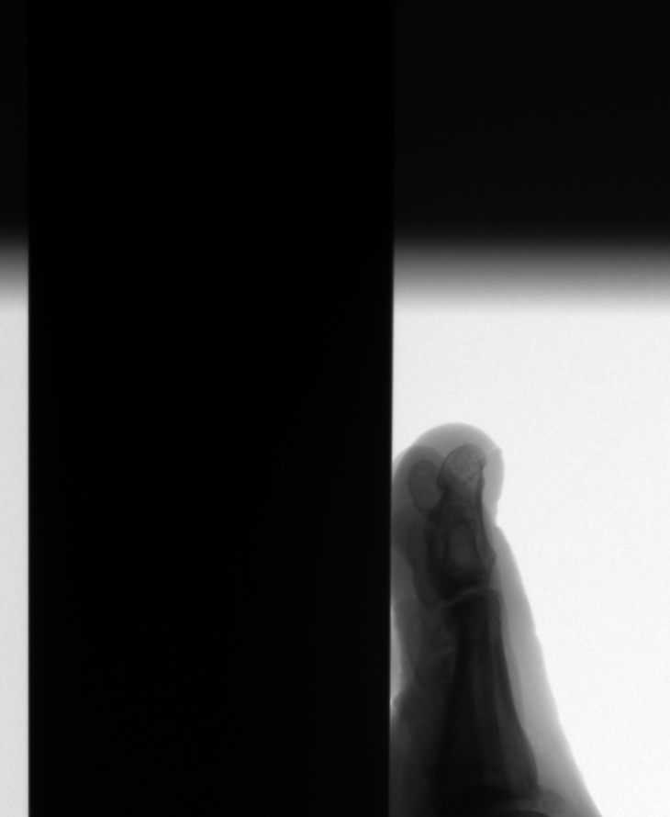
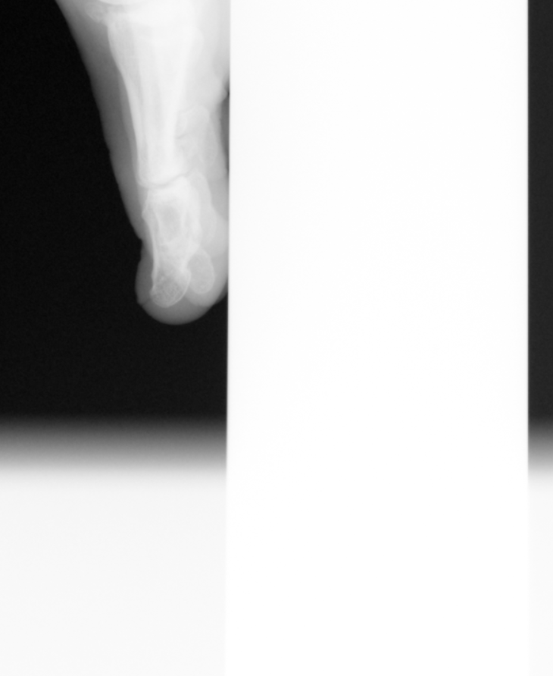
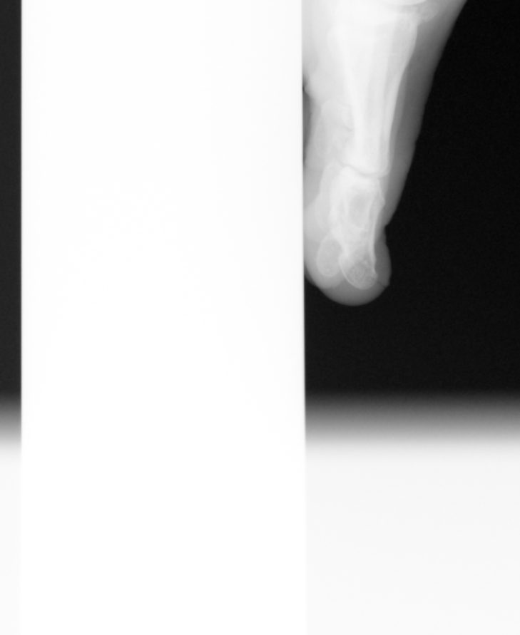
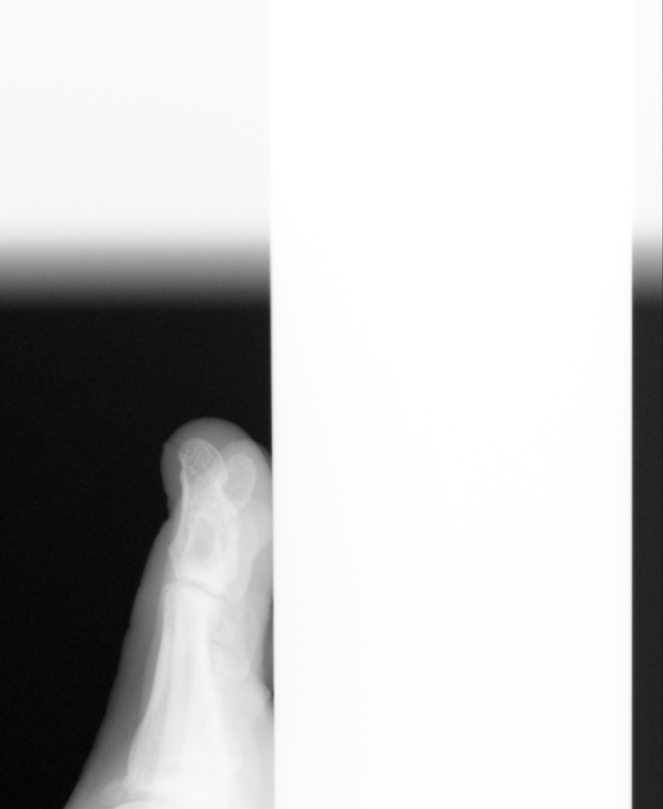
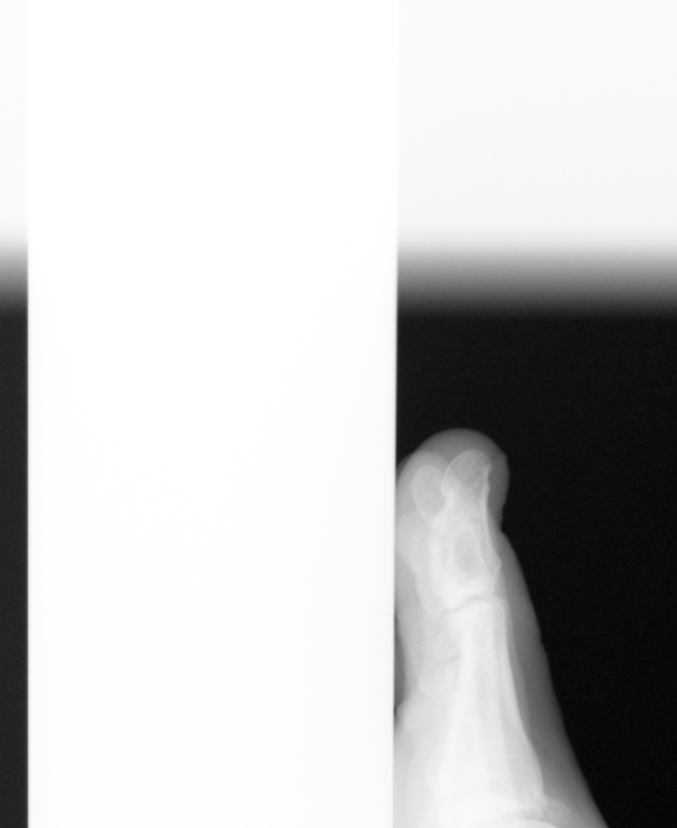
Dataset preprocessing
Original
Vertical flip
Horizontal flip
Flip-both
Invert
Invert Vertical
flip
Invert Horizontal
flip
Invert Flip-both

Slide 12
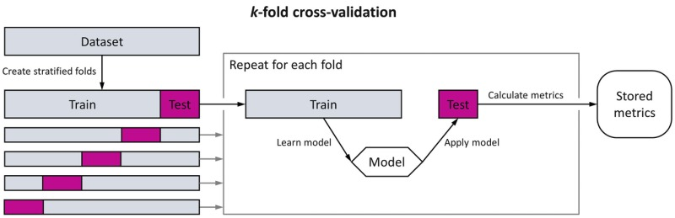
Dataset preprocessing
Train - validation 80-20%
5 fold

Slide 13
Content
Motivation
Problem Statement
Dataset and Dataset preprocessing
Experiments
Image based
Time based
One-class-classifier
Comparative result analysis
Discussion and future outlook

Slide 14
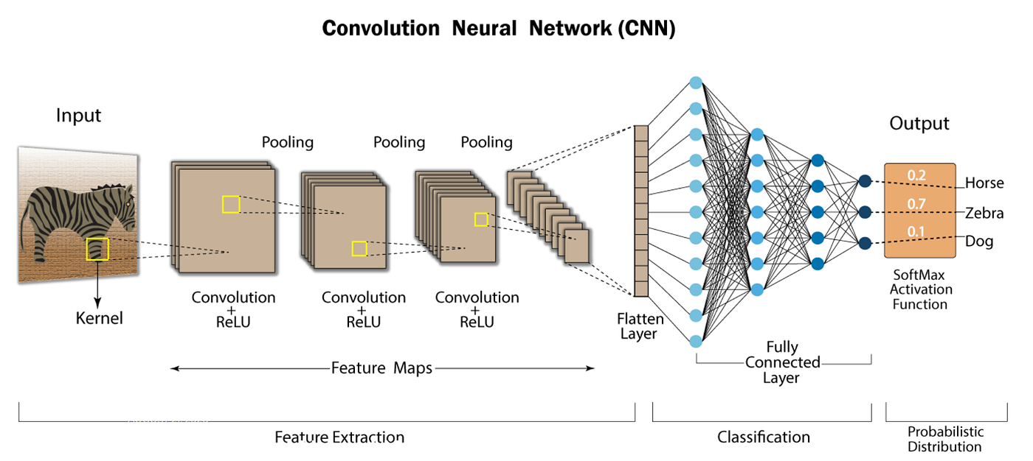
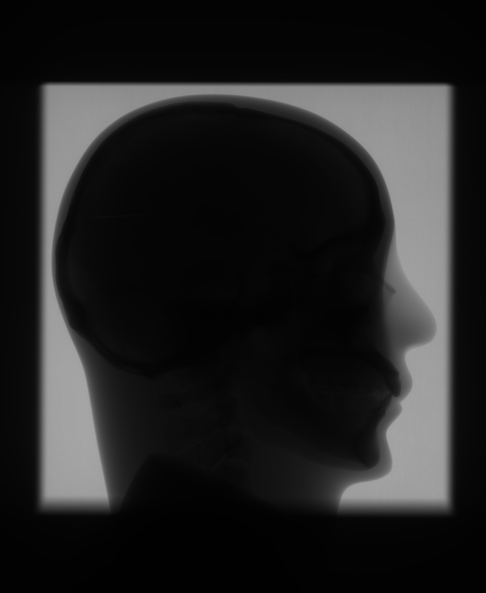
Image-based Approach
ResNet-18 (pretrained with ImageNet)
Input: Raw X-ray image patches (783,955)
“7“
class
FX02
FX00
Good

Slide 15

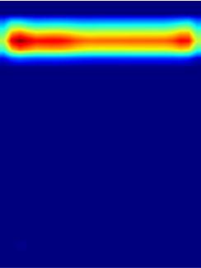
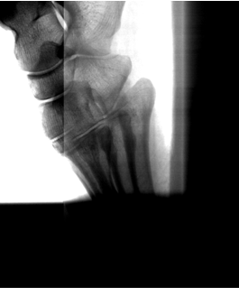
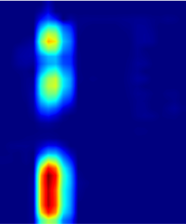
Explainability
Grad-CAM
Fig: Artifacts and its explainabilty

Slide 16
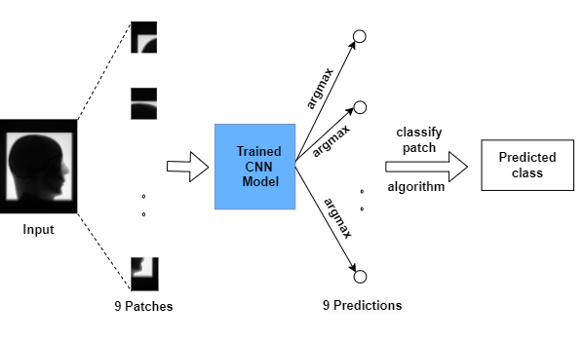
Inference Phase

Slide 17
Idea of line profile
Insight: All the defects are straight line
Convert image into time series
Directional

Slide 18
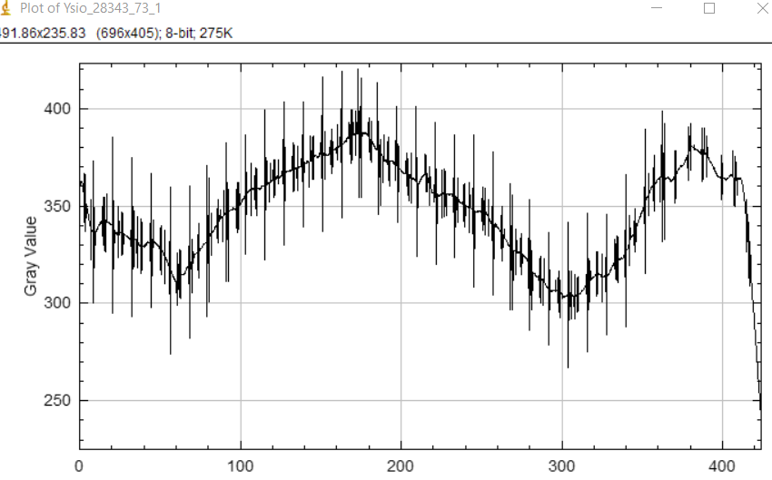
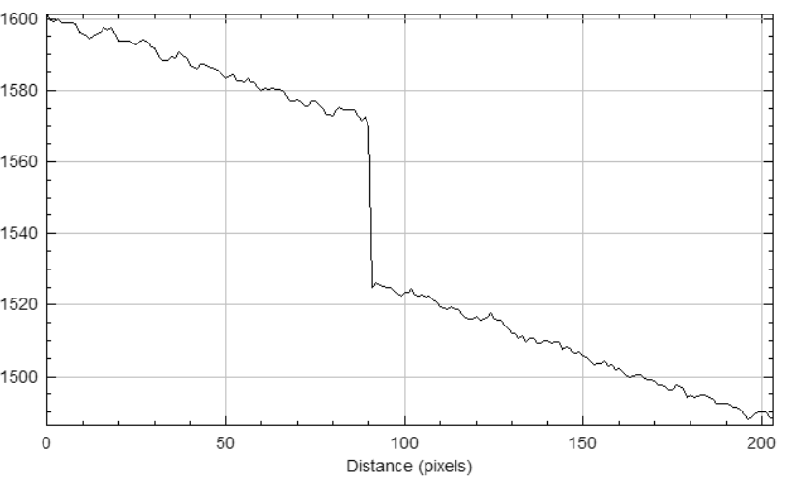
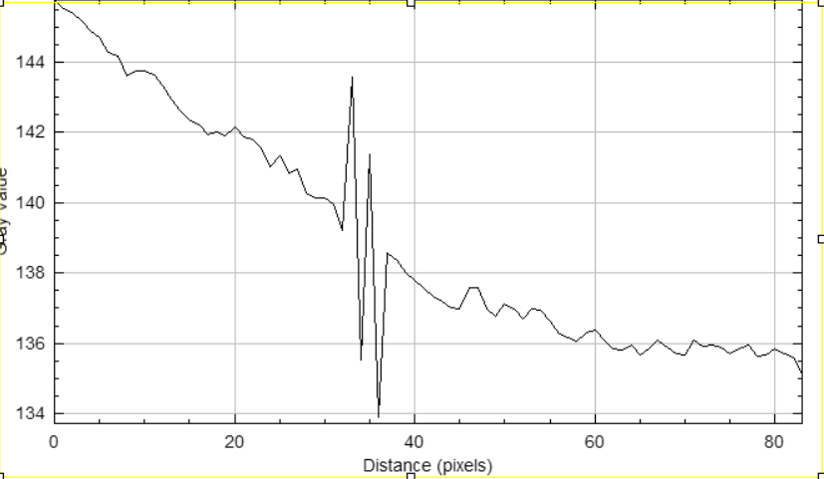
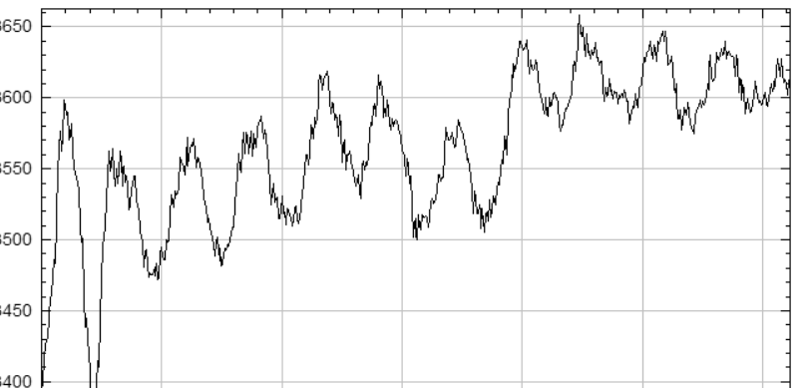
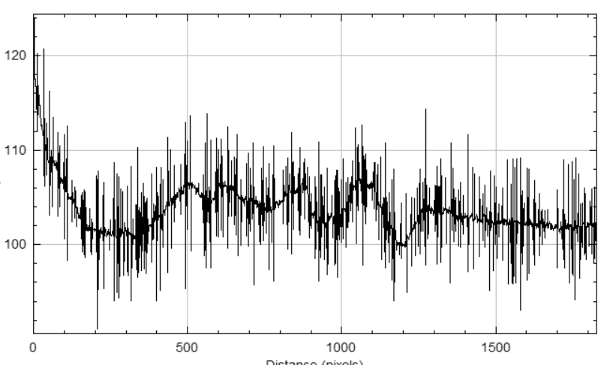
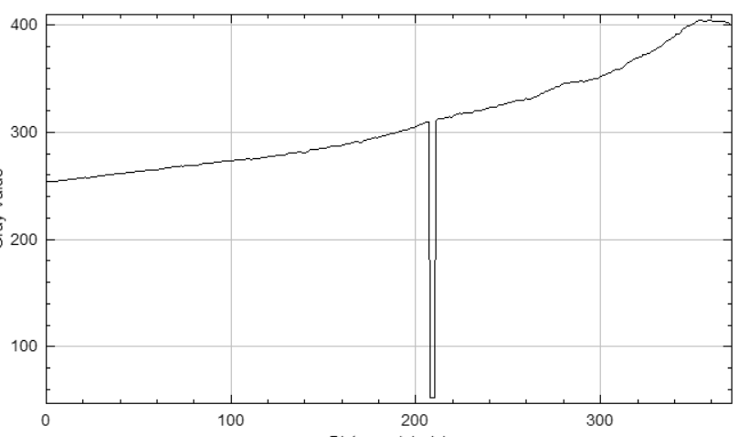
Line profiles
Sporadic
- Horizontal
Partly Bright/Dark
- Vertical
Group of defect
- Horizontal/Vertical
Stripes
- Horizontal
Group of line
- Horizontal
Defect line
- Horizontal/Vertical

Slide 19
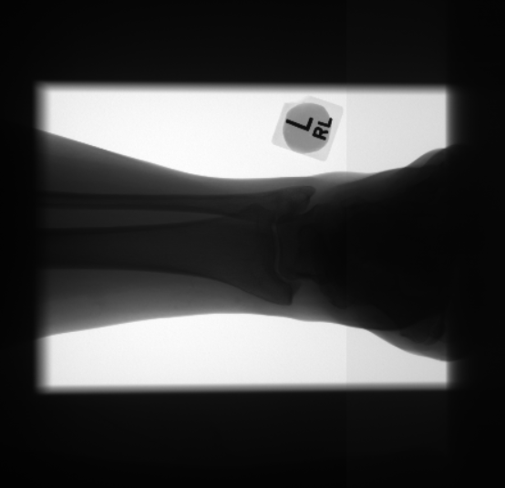
Time series- based classification
Rationale
Less memory requirements
Resistant to noise
No need of patching

Slide 20
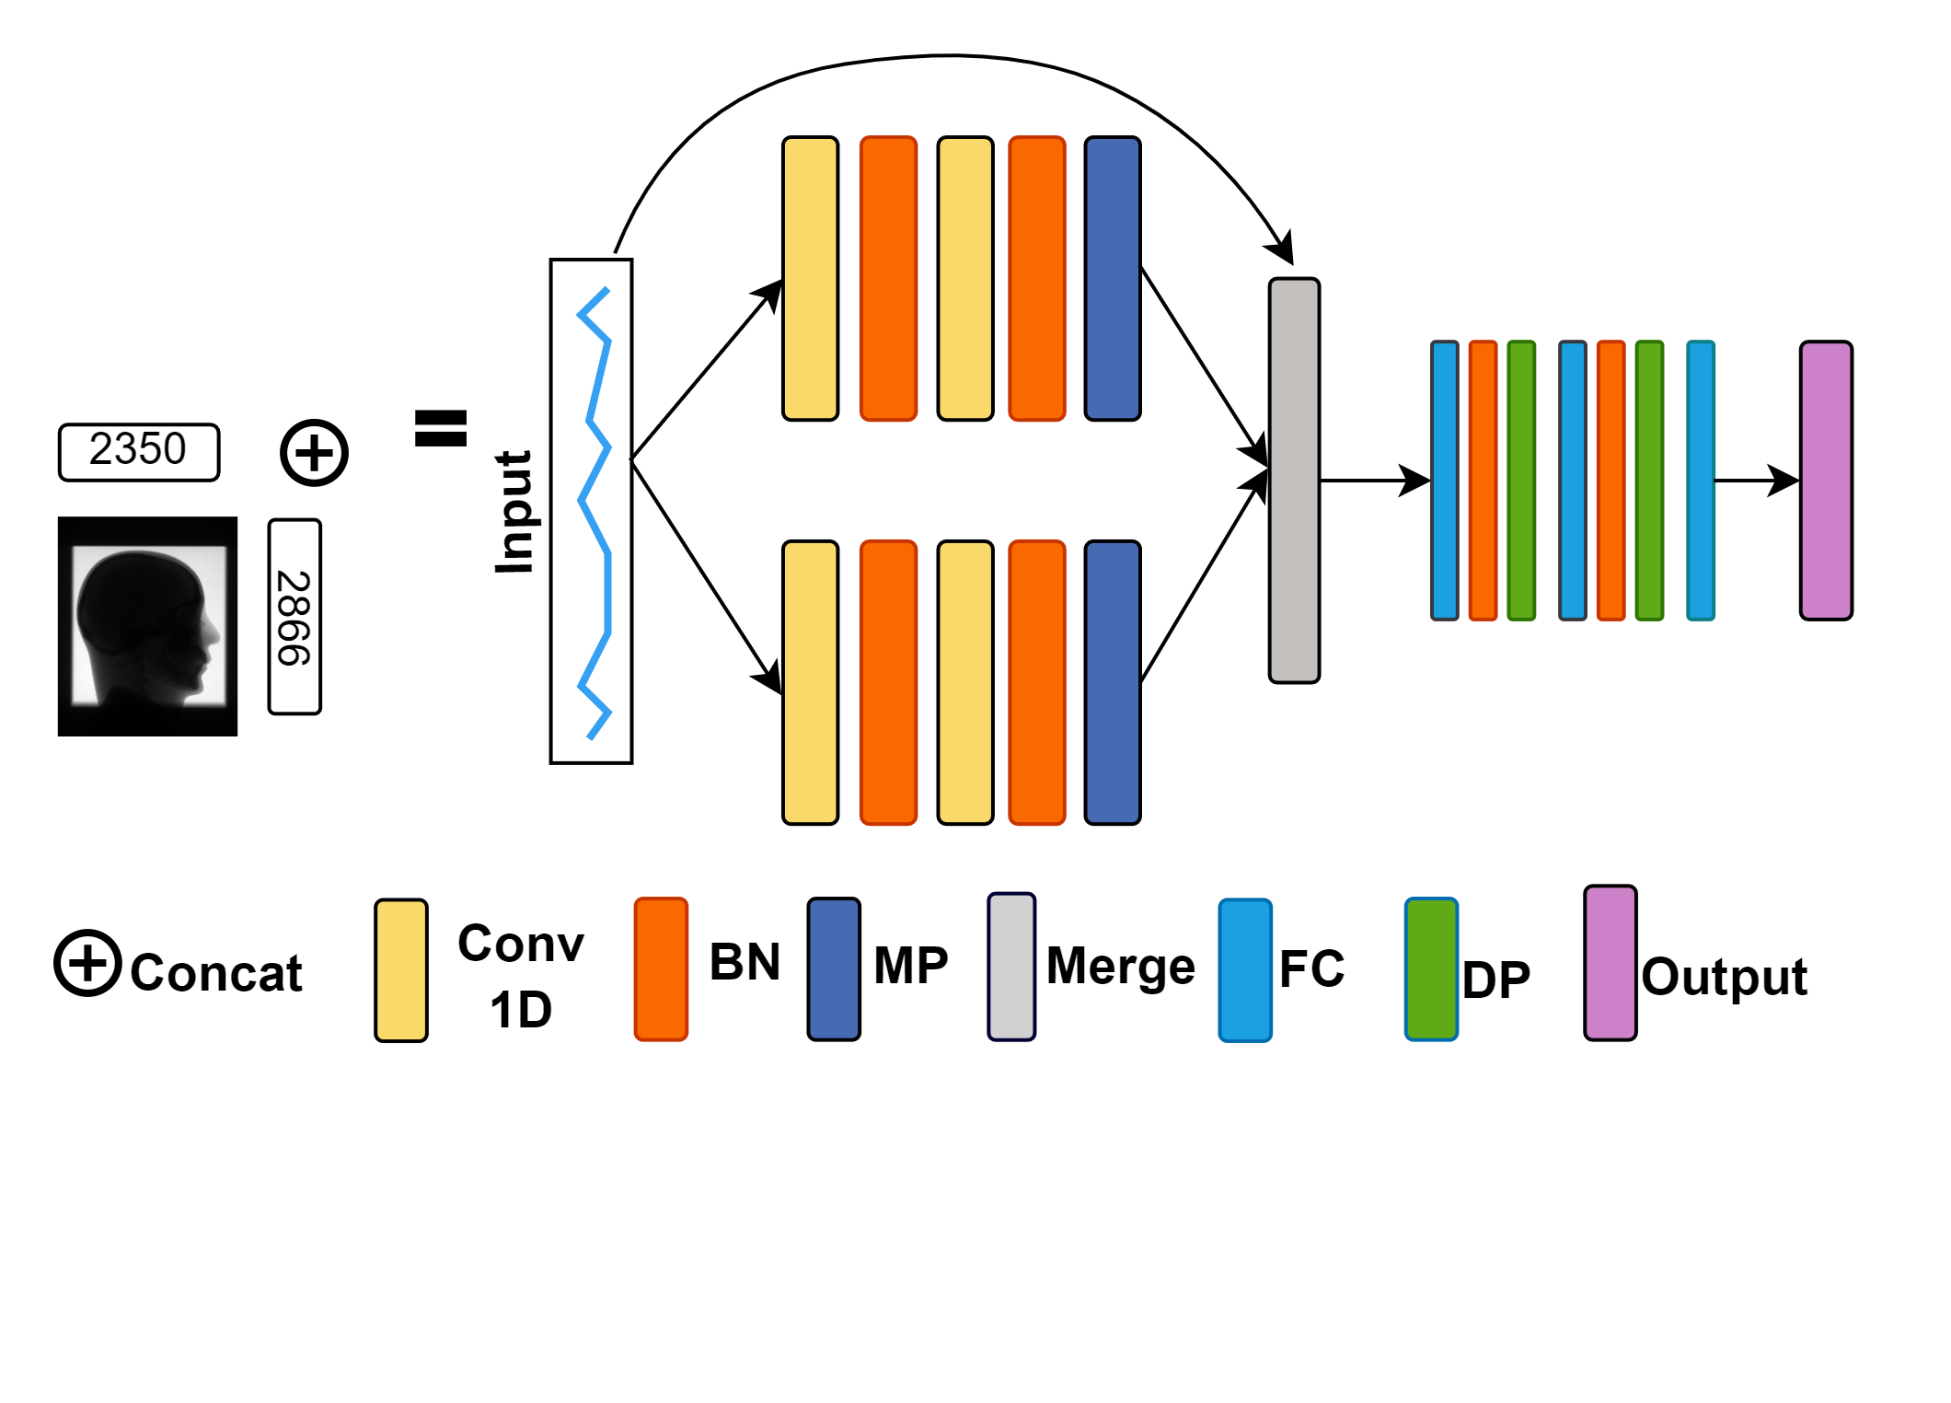
Time series- based classification
In-house developed 1DCNN model
“7“ Class

Slide 21
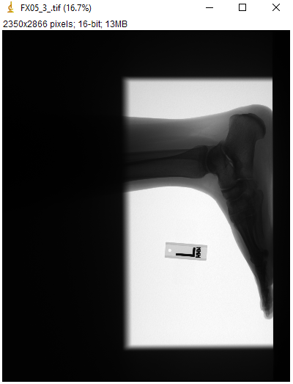
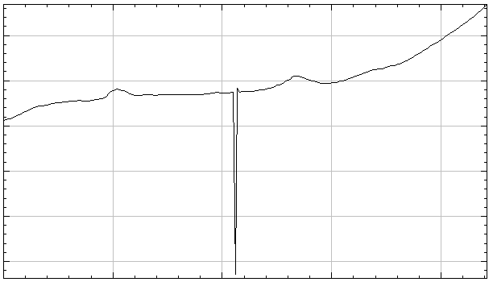



Explainability
Saliency Maps
Example: Defect line
C
A
D
B
E

Slide 22

One Class Classification
Binary Classification
Data | Count
Train
Good | 4684
Test
Good | 521
Defective | 1129

Slide 23




One class classification
[A] Good
[B] Good
[C] FX05_Defect Line
[D] FX09_Stripes

Slide 24


One class classification
Threshold = 44.7

Slide 25



Post-processed images
Often cropped; varied shape
Check model trained for intensity linear raw X-ray, works for post-processed images
Idea: Using confidence of model

Slide 26

Post-processed analysis
Image based

Slide 27


Post-processed analysis
Line Profile

Slide 28
Comparative Study Analysis
 | CNN-based | One class classifer | Time series-based
Works on | Image-patch | Image-patch | Line profiles
Preprocessing | Making patches of image, label each patch manually | Making patches of image, label each patch manually | Extract row and column profile and concatenate
Does classification | multiclass | binary | multiclass
Training needs | GPU | GPU | GPU or CPU
Epochs trained for | 30 | 1640 | 30
Training time(GPU) | 147 min 23 secs | 78 hours | 3min 2secs
Training time(CPU) | - | - | 14min 36sec
Works for post-processed? | Yes | - | No

Slide 29
Comparative Study Analysis
As multi-class classification
 | Precision | Recall | F1 | Accuracy
CNN | 0.986 | 0.986 | 0.986 | 98%
1DCNN | 0.963 | 0.961 | 0.961 | 96.6%
Binary classification
 | Precision | Recall | F1 | Accuracy
CNN | 0.977 | 0.980 | 0.978 | 98.2%
OC-VAE | 0.844 | 0.847 | 0.844 | 84.4%
1DCNN | 0.968 | 0.968 | 0.968 | 96.8%

Slide 30
Content
Motivation
Problem Statement
Dataset and Dataset preprocessing
Experiments
Image based
Time based
One-class-classifier
Comparative result analysis
Discussion and future outlook

Slide 31
Discussion
Image based approach
Time Series
One class classification
Achieved highest accuracy - 98% Works for post-processed images | Manual patching
Less computational requirement Less storage space | Works on assumption that defects are straight lines Doesn‘t seem to work directly with post-processed images
Could classify unseen artifact | High computational requirement Longer training time

Slide 32
Discussion
Cho et. al’s – ‘How much data is needed to train a medical image deep learning system to achieve necessary high accuracy?’ suggest a minimum of 4092 samples per class for achieving a 99.5% accuracy in medical imaging models
‘Context-encoding Variational Autoencoder for Unsupervised Anomaly Detection’ use 140k images of 64 × 64 size for training autoencoder to find anomaly in CT slices for achieving AUC-ROC of 0.76

Slide 33
Future work
Data collection and test
Data resizing exploration
Adapting to new artifact classes
Cross detector generalization
Artifact segmentation
Single label to multi-label

Slide 34
Thank You

